Slide 1
Getting the Most out of HTC with Workflows Friday morning, 9:00 am
Christina Koch ckoch5@wisc.edu
Research Computing Facilitator
University of Wisconsin - Madison

Slide 2
Why are we here?

Slide 3

Why are we here?
To do SCIENCE!!!
A lot of science is best-done with computing – sometimes, LOTS of computing
Science needs to be reproducible
And, we’d really like science to happen fast(er)

Slide 4
Getting the most out of Computing (for research)

Slide 5
Computing types
At the beginning of the week, we talked about two different approaches for tackling large compute tasks...
high-throughput
high-performance (e.g.MPI)

Slide 6
Two Strategies
High Throughput
High Performance
Focus: Workflows with many small, largely independent compute tasks
Optimize: throughput, or
time from submission to overall completion
Focus: Workflows with large, highly coupled tasks
Optimize: individual tasks, software, communication between processes

Slide 7
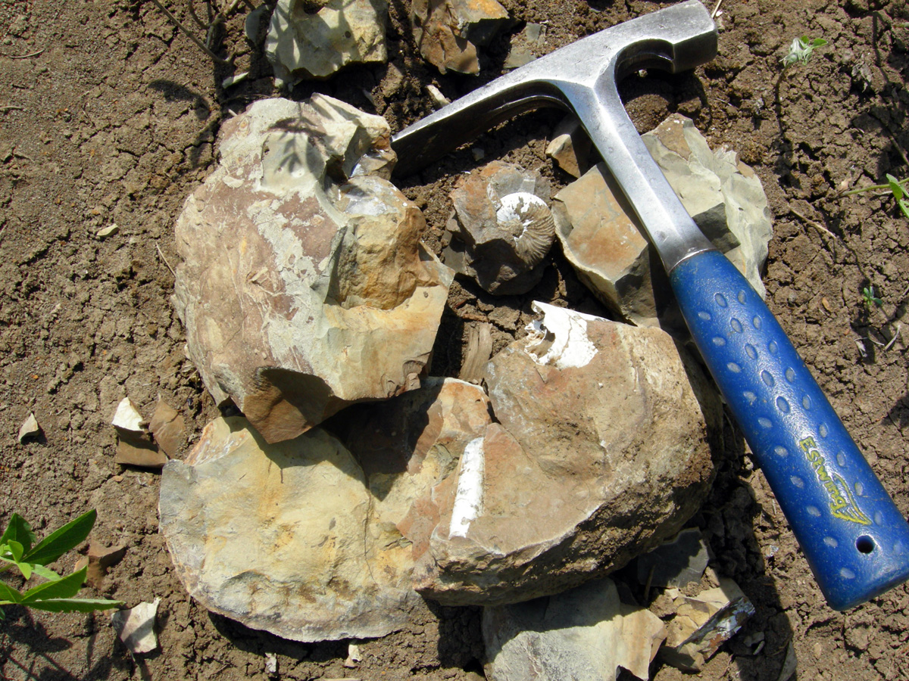
Making Good Choices
How do you choose the best approach?
Guiding question:
Is your problem “HTC-able”?

Slide 8
Typical HTC Problems
batches of similar program runs (>10)
“loops” over independent tasks
others you might not think of …
programs/functions that
process files that are already separate
process columns or rows, separately
iterate over a parameter space
a lot of programs/functions that use multiple CPUs on the same server
Ultimately: Can you break it up?

Slide 9
What is not HTC?
fewer numbers of jobs
jobs individually requiring significant resources
RAM, Data/Disk, # CPUs, time
(though, “significant” depends on the HTC compute system you use)
restrictive licensing

Slide 10

The Real World
However, it’s not just about finding the right computing approach to your problem.
These approaches will be *most* effective if they’re running on appropriate compute systems.

Slide 11
The Real World
Not all compute systems are created equal.
Two questions to ask:
What resources are available to me?
Which one is the best match for the kind of computing I want to do?

Slide 12
Campus Resources
Start with your local campus compute system
Some considerations:
Who has access? Are there allocations?
What kind of system? What is it optimized for?
An HPC cluster may not handle lots of jobs well, in the same way that an HTC system has limited multicore capabilities - be aware of how a system matches/doesn’t match your computation strategy.
Ask questions! Be a good citizen!
If local resources are limited, explore other options.

Slide 13



Beyond your campus
Open Science Grid!
This afternoon, Tim will talk about ways to access OSG after the school is over
Other grids
European Grid Infrastructure
Other national and regional grids
Commercial cloud systems

Slide 14
The payoff
HTC is, beyond everything, scalable
If you can run 10 jobs, you can run 10,000, maybe even 10 million
Worth pursuing the right kind of resources (if you can) for the right kind of problem.
n processors
time

Slide 15
Getting the Most out of HTC

Slide 16
Key HTC Tactics
Increase Overall Throughput
Utilize Resources Efficiently!
Bring Dependencies With You
Scale Gradually, Testing Generously
Automate As Many Steps As Possible

Slide 17
Throughput, revisited
In HTC, we optimize throughput: time from submission to overall completion
Instead of making individual jobs as fast as possible, optimize how long it takes for all jobs to finish.
We do this by breaking large processes into smaller pieces

Slide 18
Breaking up is hard to do…
Ideally into parallel (separate) jobs
reduced job requirements = more matches
not always easy or possible
Strategies
break HTC-able steps out of a single program
break up loops
break up input
Use self-checkpointing if jobs are too long

Slide 19
Batching (Merging) is easy
A single job can
execute multiple independent tasks
execute multiple short, sequential steps
avoid transfer of intermediate files
Use scripts!
need adequate error reporting for each “step”
easily handle multiple commands and arguments

Slide 20
Key HTC Tactics
Increase Overall Throughput
Utilize Resources Efficiently!
Bring Dependencies With You
Scale Gradually, Testing Generously
Automate As Many Steps As Possible

Slide 21
Know and Optimize Job Use of Resources!
CPUs (“1” is best for matching; essential for OSG)
restrict, if necessary/possible
software that uses all available CPUs is BAD!
CPU Time
> ~5 min, < ~1 day; Ideal: 1-2 hours
RAM (not always easily modified)
Disk per-job (execute) and in-total (submit)
Network Bandwidth
minimize transfer: filter/trim/delete, compress

Slide 22
Use the job log
001 (2576205.000.000) 06/07 11:57:57 Job executing on host: <128.104.101.248:9618>
005 (2576205.000.000) 06/07 14:12:55 Job terminated.
(1) Normal termination (return value 0)
Usr 0 00:00:00, Sys 0 00:00:00 - Run Remote Usage
Usr 0 00:00:00, Sys 0 00:00:00 - Run Local Usage
Usr 0 00:00:00, Sys 0 00:00:00 - Total Remote Usage
Usr 0 00:00:00, Sys 0 00:00:00 - Total Local Usage
5 - Run Bytes Sent By Job
104857640 - Run Bytes Received By Job
5 - Total Bytes Sent By Job
104857640 - Total Bytes Received By Job
Partitionable Resources : Usage Request Allocated
Cpus : 1 1
Disk (KB) : 122358 125000 13869733
Memory (MB) : 30 100 100

Slide 23
Key HTC Tactics
Increase Overall Throughput
Utilize Resources Efficiently!
Bring Dependencies With You
Scale Gradually, Testing Generously
Automate As Many Steps As Possible

Slide 24
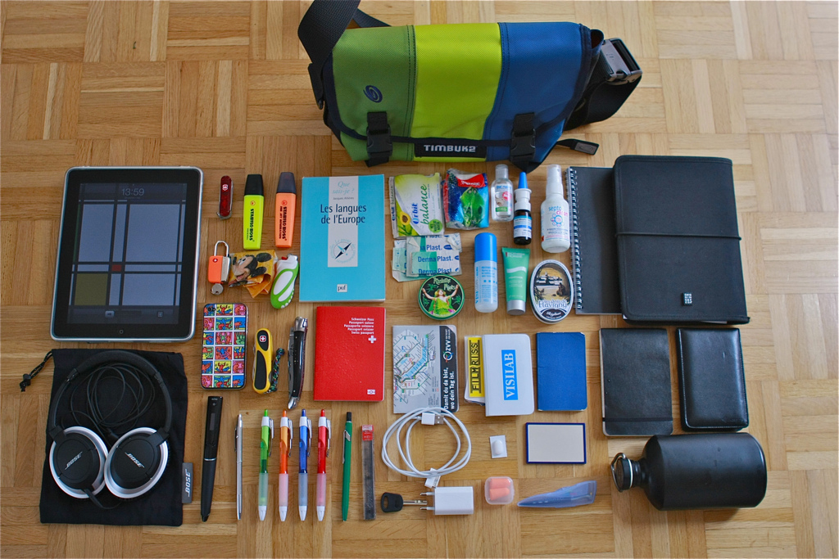
Bring What with You?
Software (covered Wednesday)
Data and other input files
Parameters and random numbers: generate and record ahead of time (for reproducibility)
What else?

Slide 25
Wrapper Scripts are Essential
Before task execution
transfer/prepare files and directories
setup/configure software environment and other dependencies
Task execution
prepare complex commands and arguments
batch together many ‘small’ tasks
After task execution
filter/combine/compress files and directories
check for and report on errors

Slide 26
Key HTC Tactics
Increase Overall Throughput
Utilize Resources Efficiently!
Bring Dependencies With You
Scale Gradually, Testing Generously
Automate As Many Steps As Possible

Slide 27
Testing, testing, testing!
Will be a major focus of our exercises today.
Allows you to optimize resource use (see HTC tactic #2)
Just because it worked for 10 jobs, doesn’t mean it will work for 10,000 jobs (scaling issues)
Data transfer (in and out)
Discover site-specific problems

Slide 28
Key HTC Tactics
Increase Overall Throughput
Utilize Resources Efficiently!
Bring Dependencies With You
Scale Gradually, Testing Generously
Automate As Many Steps As Possible

Slide 29
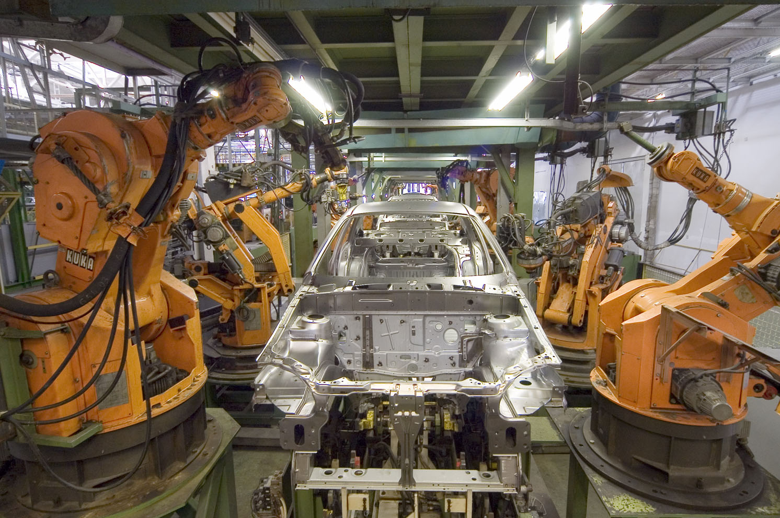
What to Automate?
Submitting many jobs (using HTCondor)
Writing submit files using scripts
Running a series of jobs, or workflow

Slide 30
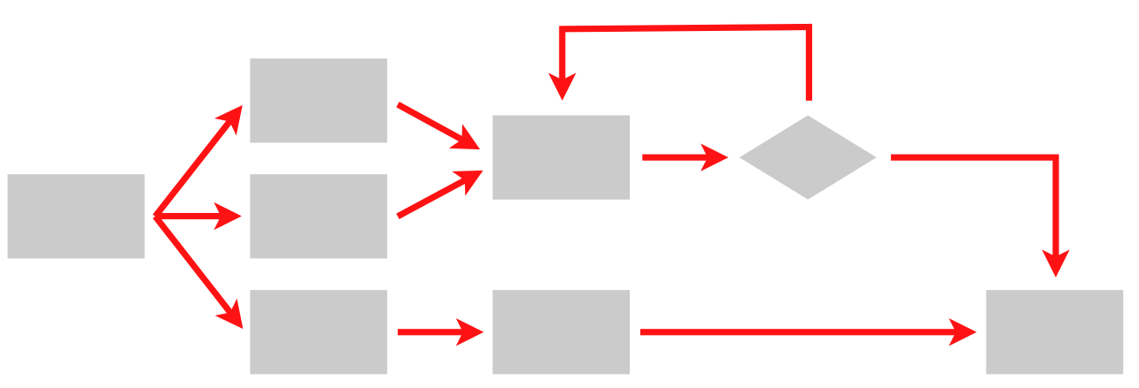
What is a workflow?
A series of ordered steps
Steps
Connections
(Metadata)

Slide 31
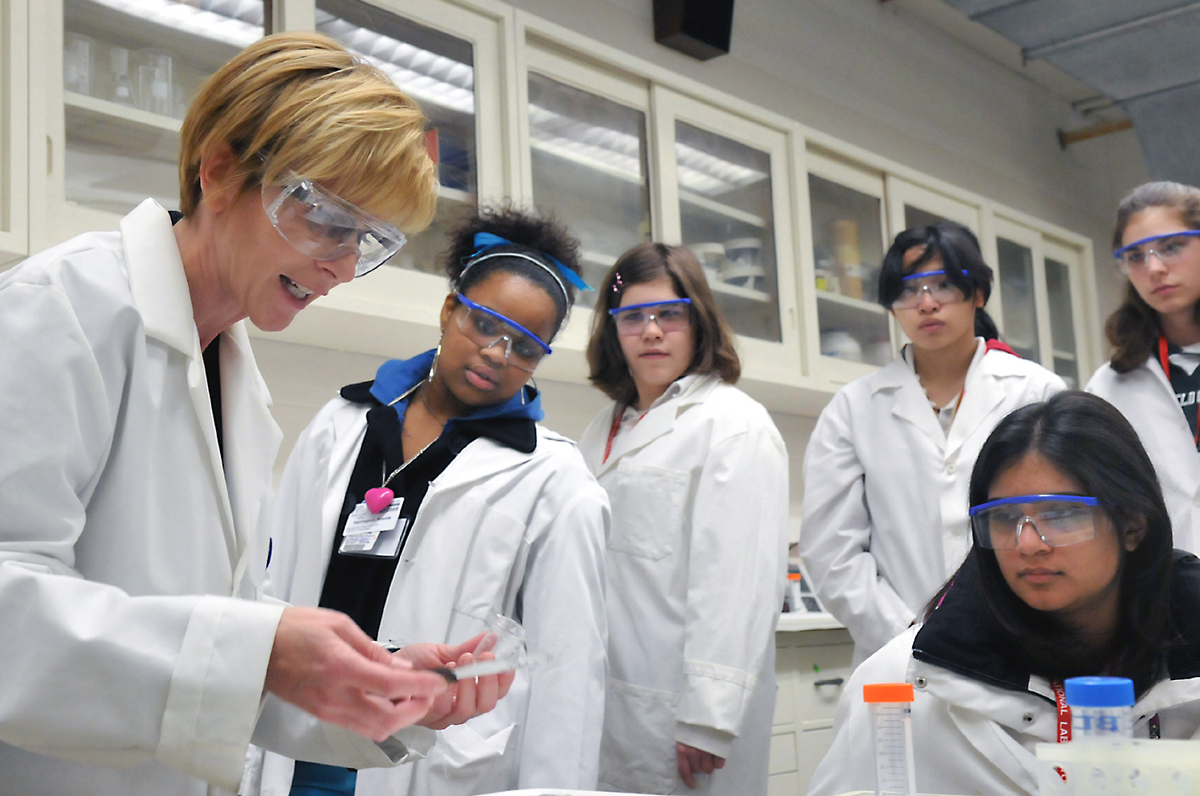
We workflows
non-computing “workflows” are all around you, especially in science
instrument setup
experimental procedures and protocols
when planned/documented, workflows help with:
organizing and managing processes
saving time with automation
objectivity, reliability, and reproducibility
(THE TENETS OF GOOD SCIENCE!)

Slide 32
DAGs Automate Workflows
data prep/split
. . .
process ‘0’
process ’99’
combine, assess results

Slide 33
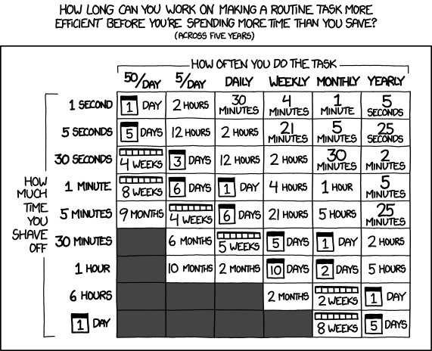
Automating workflows can save you time...
http://xkcd.com/1205/

Slide 34
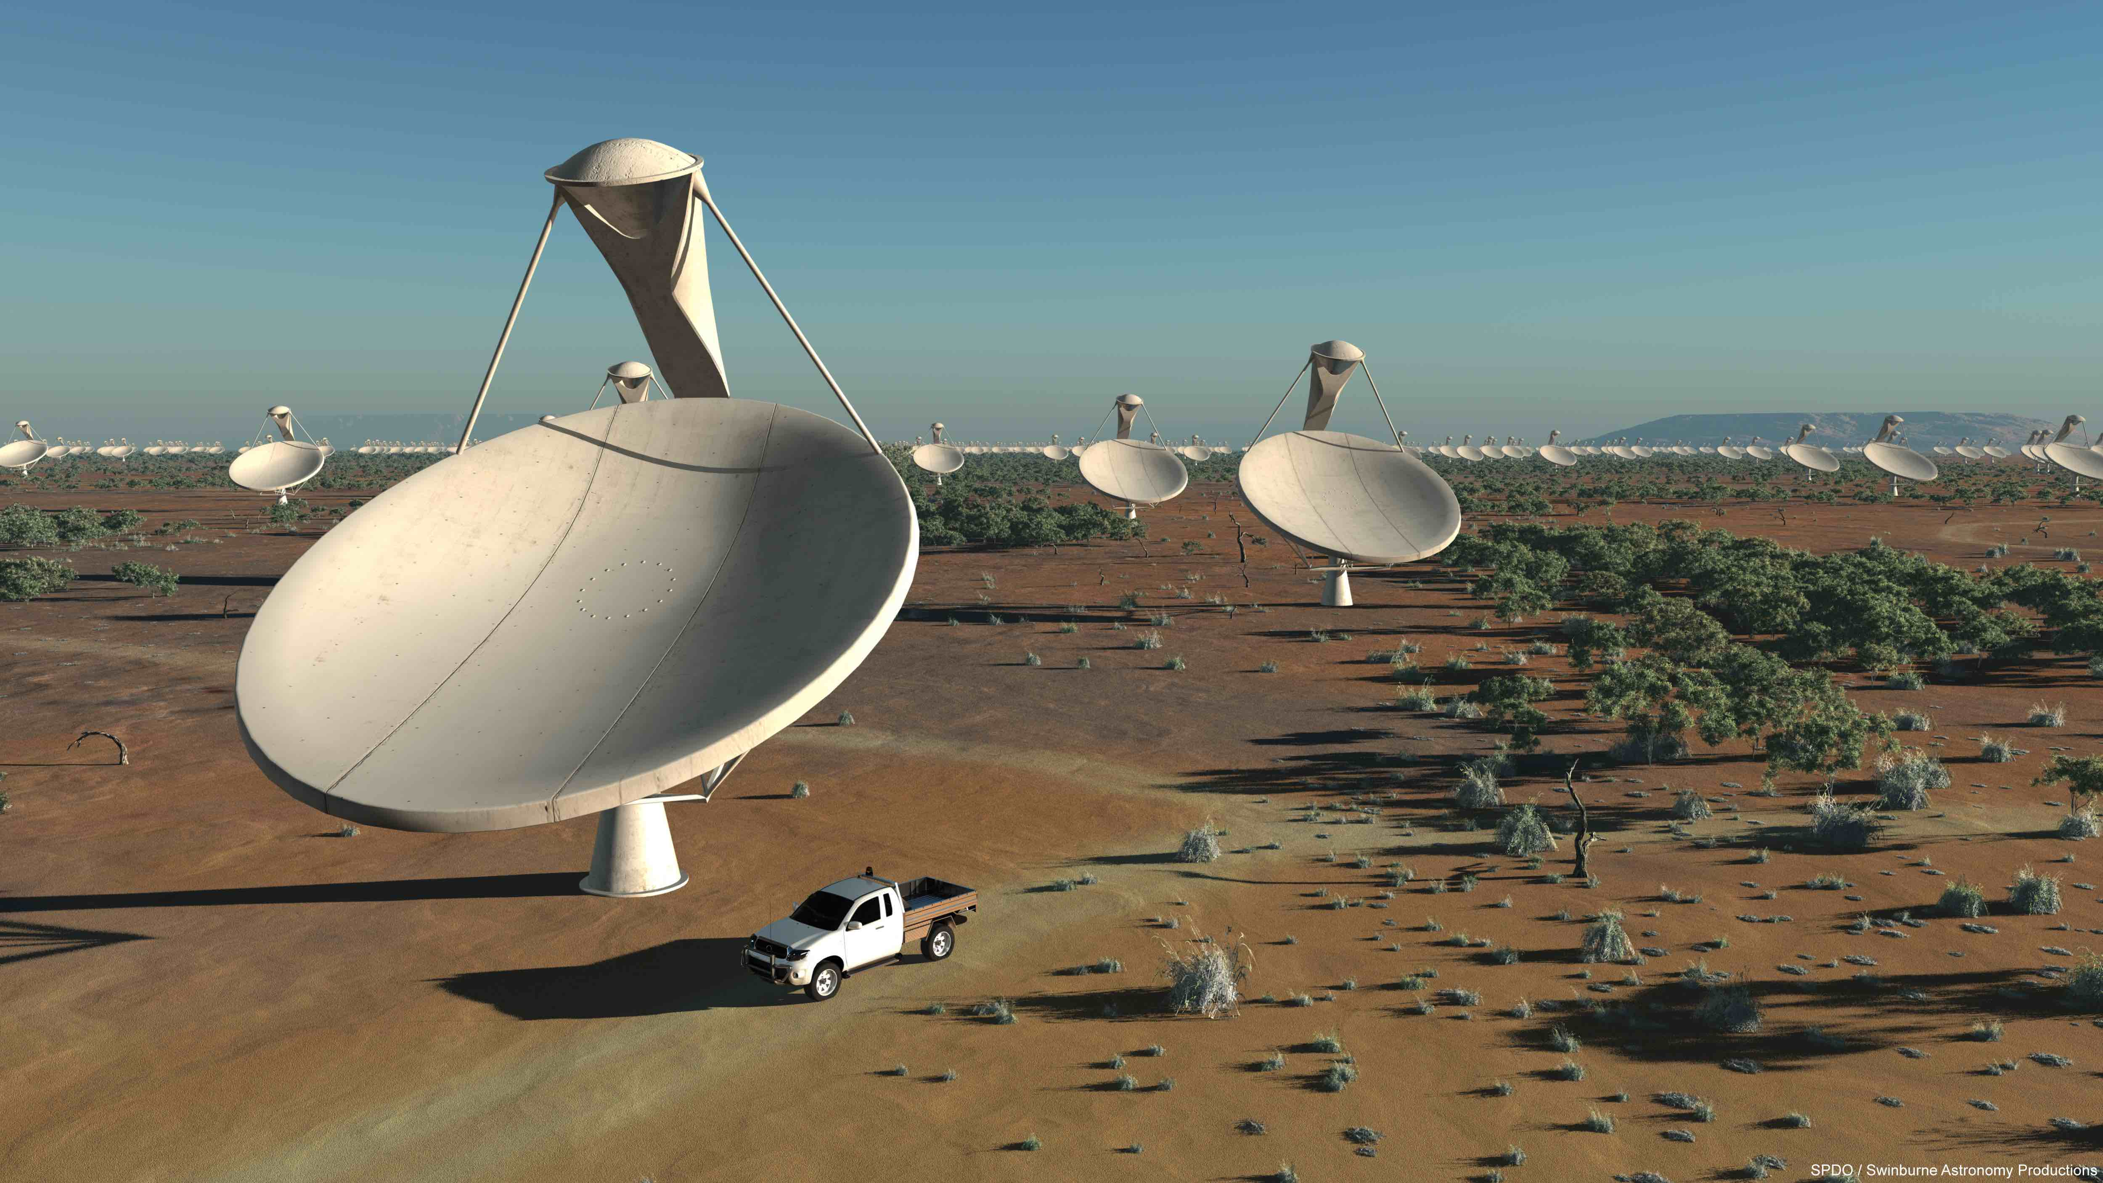
… but there are even more benefits of automating workflows
Reproducibility
Building knowledge and experience
New ability to imagine greater scale, functionality, possibilities, and better SCIENCE!!

Slide 35
Getting the most out of workflows, part 1

Slide 36
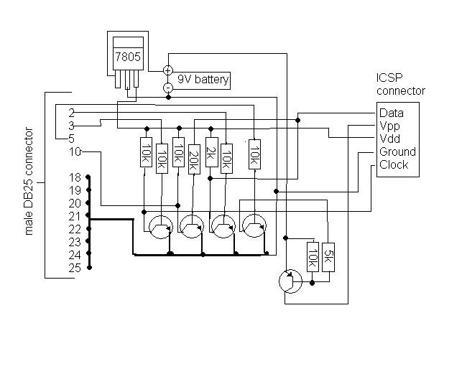
From schematics…

Slide 37
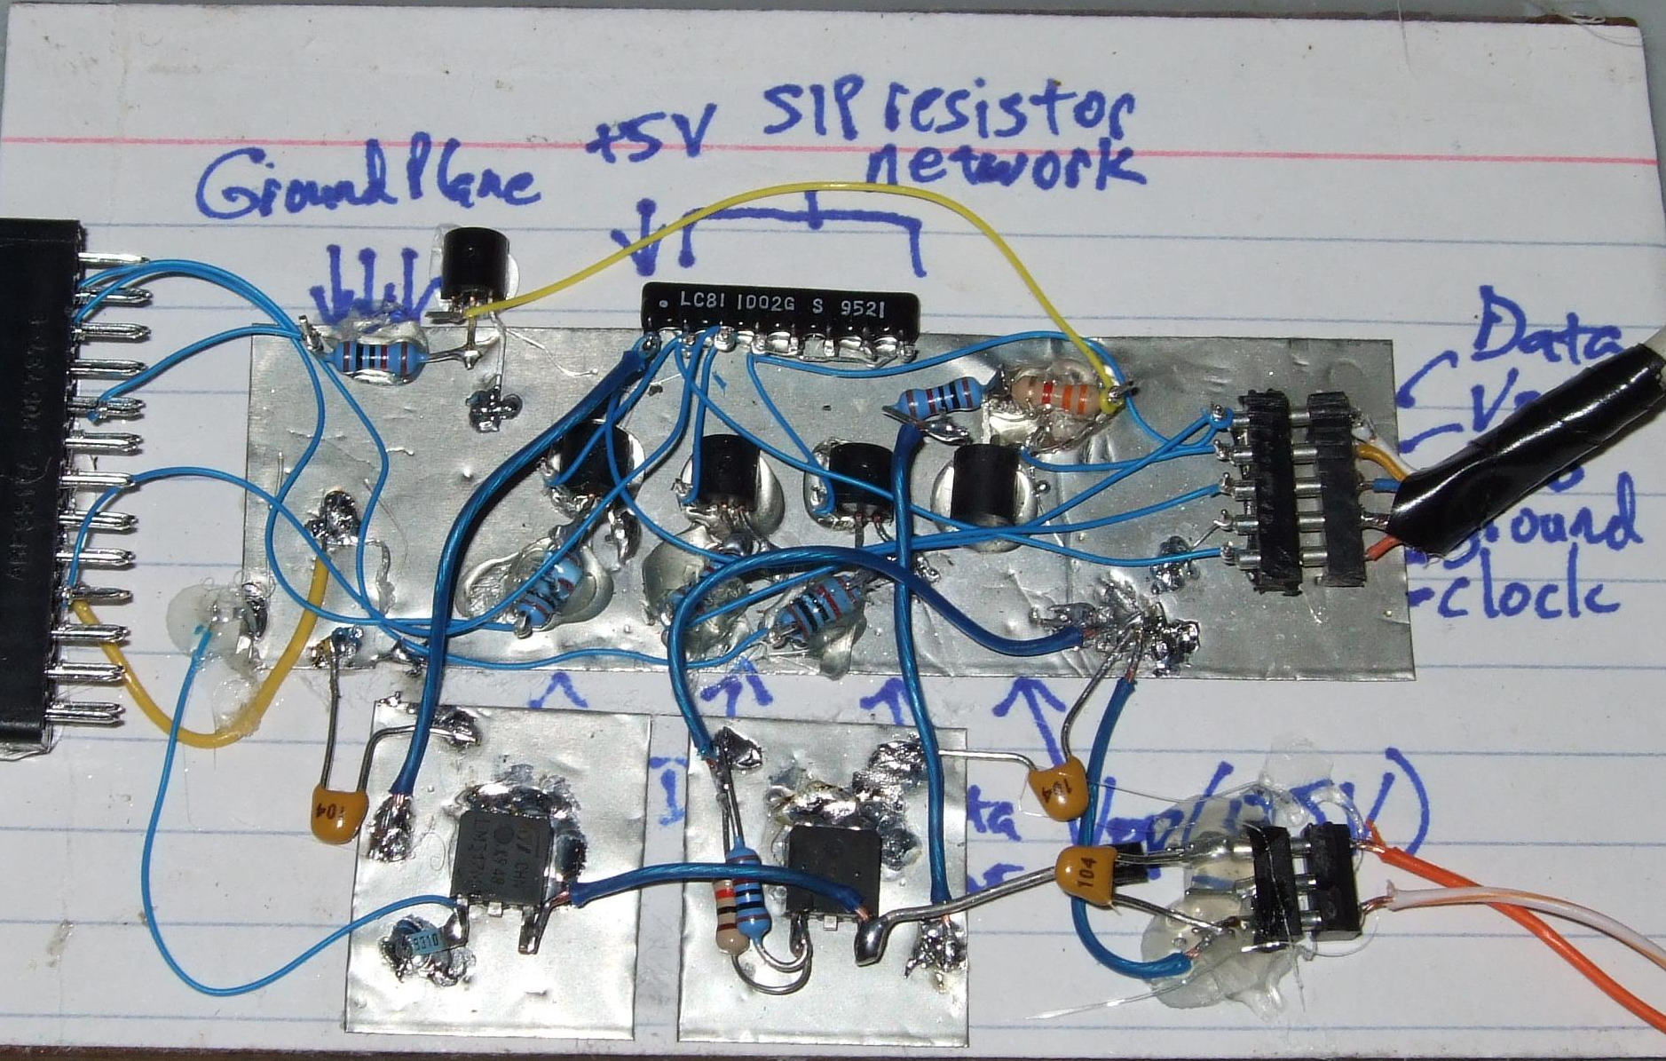
… to the real world

Slide 38
Building a Good Workflow
Draw out the general workflow
Define details (test ‘pieces’ with HTCondor jobs)
divide or consolidate ‘pieces’
determine resource requirements
identify steps to be automated or checked
Build it modularly; test and optimize
Scale-up gradually
Make it work consistently
What more can you automate or error-check?
(And remember to document!)

Slide 39
Workflow, version 1
data prep (minutes)
processing
(days)
assess results
(minutes)

Slide 40
Workflow, version 2 (HTC)
data prep/split
. . .
process ‘0’
process ’99’
combine, assess results

Slide 41
Building a Good Workflow
Draw out the general workflow
Define details (test ‘pieces’ with HTCondor jobs)
divide or consolidate ‘pieces’
determine resource requirements
identify steps to be automated or checked
Build it modularly; test and optimize
Scale-up gradually
Make it work consistently
What more can you automate or error-check?
(And remember to document!)

Slide 42
Determine Resource Usage
Run locally first
Then get one job running remotely
(on execute machine, not submit machine)!
get the logistics correct! (HTCondor submission, file and software setup, etc.)
Once working, run a couple of times
If big variance in resource needs, should you take the…
Average? Median? Worst case?

Slide 43
End Up with This
(special transfer)
file prep and split
(POST-RETRY)
1 GB RAM
2 GB Disk
1.5 hours
. . .
100 MB RAM
500 MB Disk
40 min
(each)
process ‘0’
(filter output)
process ‘99’
(filter output)
(POST-RETRY)
(POST-RETRY)
(PRE)
combine, transform results
(POST-RETRY)
300 MB RAM
1 GB Disk
15 min
Notes:
Remove?

Slide 44
Exercise 1.1
Task 1
(days)
Task 2
(minutes)
Notes:
REMAKE!!!

Slide 45
Exercise 1.1
. . .
process ‘0’
process ‘?’
Task 2
Notes:
REMAKE!!!

Slide 46
Exercise 1.2
. . .
? RAM
? MB Disk
? min
(each)
process ‘0’
(filter output)
process ‘?’
(filter output)
(POST?)
(POST?)
(PRE?)
Task 2
(POST?)
? RAM
? GB Disk
? min
Notes:
REMAKE!!!

Slide 47
Questions?
Now: “Joe’s Workflow” Exercise 1.1,1.2
In groups of 2-3
Read carefully!
Later:
Lecture: From Workflow to Production
Exercises 2.1, 2.2

